Slide 1
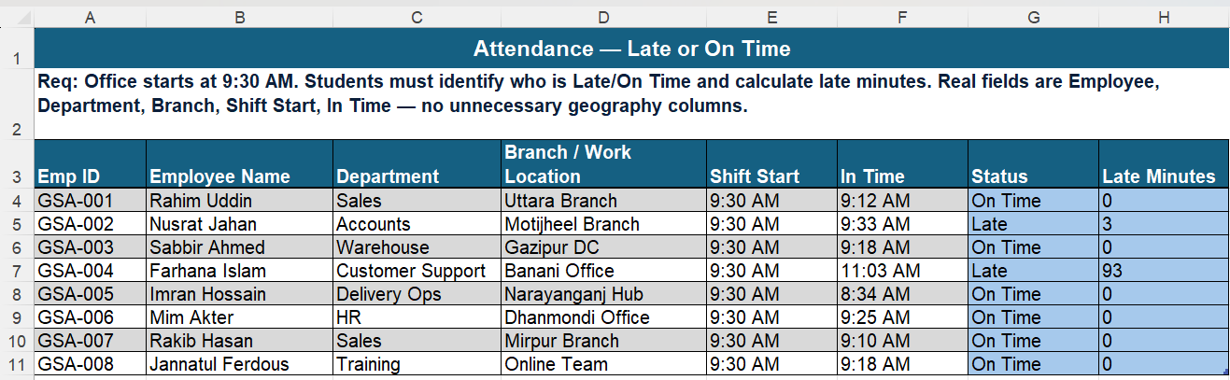
Attendance - Late or On Time
Status: =IF([@[In Time]]>[@[Shift Start]],"Late","On Time")
Late Minutes: =IF([@[In Time]]>[@[Shift Start]],([@[In Time]]-[@[Shift Start]])*1440,0)
Compares In Time against the 9:30 AM Shift Start. When late, the time difference is multiplied by 1440 (minutes in a day) to convert Excel's decimal time into actual minutes late.

Slide 2
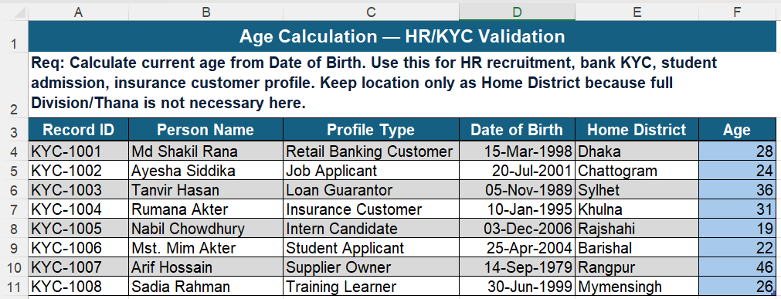
Age Calculation - HR / KYC Validation
DATEDIF
Age: =DATEDIF([@[Date of Birth]],TODAY(),"Y")
DATEDIF measures the gap between two dates. The "Y" unit returns completed full years - the standard way to calculate age for recruitment, bank KYC, and admission forms.

Slide 3
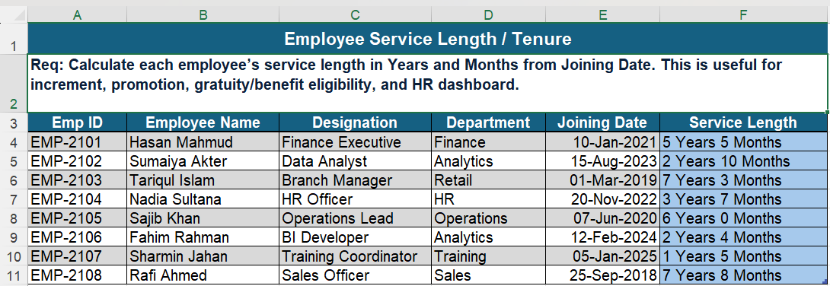
Employee Service Length / Tenure
Service Length: =DATEDIF([@[Joining Date]],TODAY(),"Y")&" Years "&DATEDIF([@[Joining Date]],TODAY(),"YM")&" Months"
Two DATEDIF calls in one formula: "Y" gives completed years and "YM" gives the leftover months, joined into a readable tenure string for increment and promotion tracking.

Slide 4
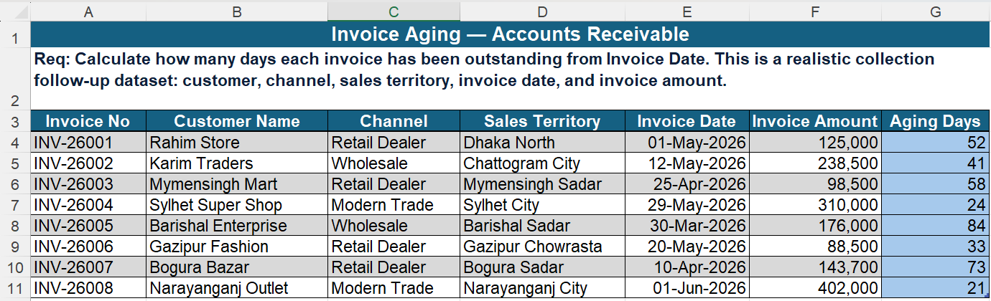
Invoice Aging - Accounts Receivable
Aging Days: =TODAY()-[@[Invoice Date]]
The simplest date math in Excel: subtracting one date from another returns the number of days between them - here, how long each invoice has been outstanding.

Slide 5
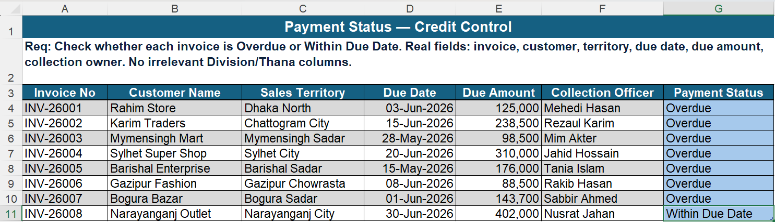
Payment Status - Credit Control
IF + Date Comparison
Payment Status: =IF([@[Due Date]]<TODAY(),"Overdue","Within Due Date")
Checks whether the due date has already passed relative to today, flagging overdue invoices so collection officers know which accounts need follow-up.

Slide 6
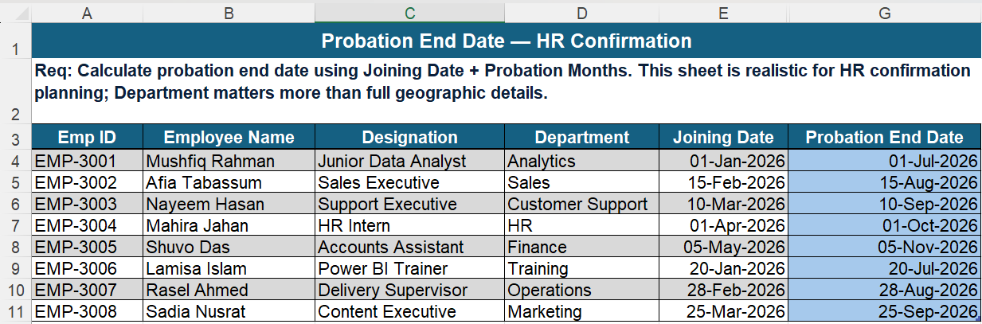
Probation End Date - HR Confirmation
Probation End Date: =EDATE([@[Joining Date]],6)
EDATE adds a set number of months to a date - here, 6 months after joining and handles month-end edge cases automatically, which manual date addition can't do reliably.

Slide 7
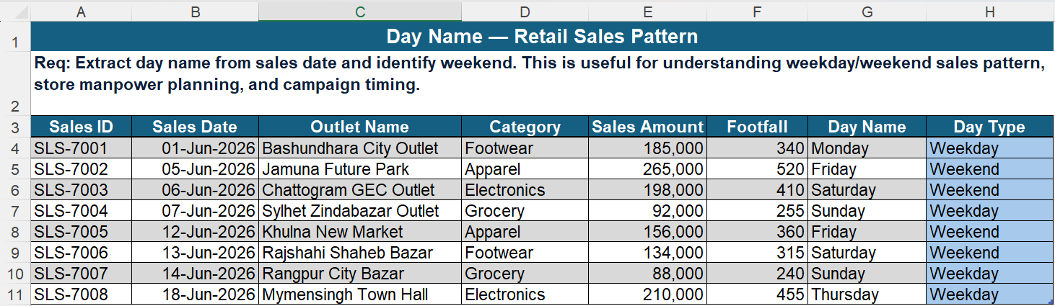
Day Name - Retail Sales Pattern
TEXT + OR + IF
Day Name: =TEXT([@[Sales Date]],"dddd")
Day Type: =IF(OR(TEXT([@[Sales Date]],"dddd")="Friday",TEXT([@[Sales Date]],"dddd")="Saturday"),"Weekend","Weekday")
TEXT converts the date into its weekday name, then OR/IF checks whether that day is Friday or Saturday - Bangladesh's weekend to reveal weekday vs weekend sales patterns.

Slide 8
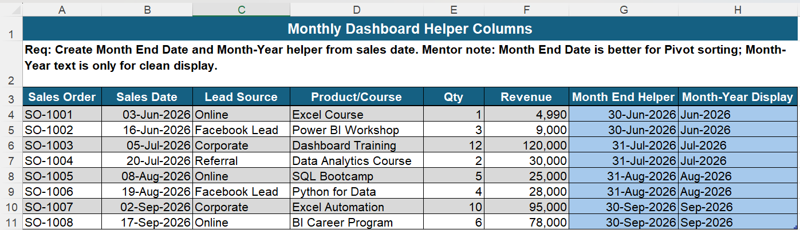
Monthly Dashboard Helper Columns
Month End Helper: =EOMONTH([@[Sales Date]],0)
Month-Year Display: =TEXT([@[Sales Date]],"mmm-yyyy")
EOMONTH(date,0) returns the real last day of the month, which sorts correctly in Pivot Tables, while TEXT formats the date as "Mmm-YYYY" purely for clean dashboard display.

